Slide 1
Code Quality 2
I told you it’s important

Slide 2
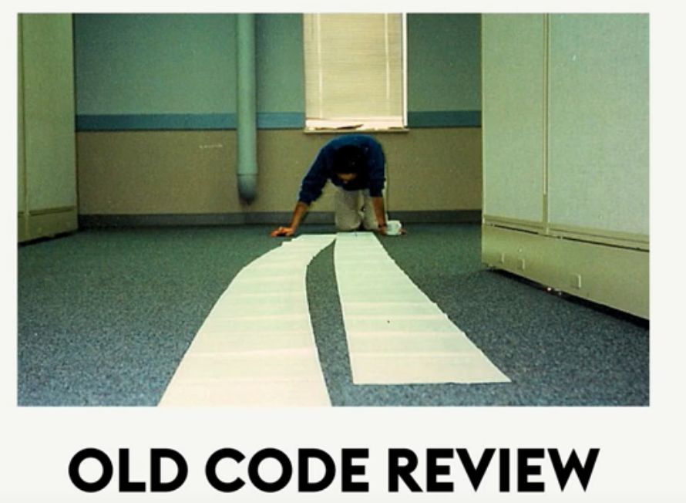
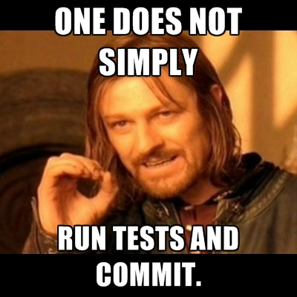
Code review

Slide 3


Why?
Make sure your code is quality enough to be add into the project codebase
Improve readability
Kill bugs
Sharing knowledge
Make you code better
better relationship
https://blog.codinghorror.com/the-ten-commandments-of-egoless-programming/

Slide 4
How
Keep the code reviewed under 400 LOC
Use automatic tool like code style checks and linting
Schedule a meeting
1 Hour

Slide 5
Code quality metrics
WTF/min
Number of Methods
Number of Fields
Number of Parameters
Lines of code.
Per file
Per method

Slide 6

The enemy of code quality
Fear
Fear of change
Use Unit Test

Slide 7
Refactor
Refactoring is not rewriting
Techniques:
Encapsulate field
Generalize type
Replace conditional with polymorphism
breaks code down into reusable units
Rename
Pull up
Push down

